Slide 1
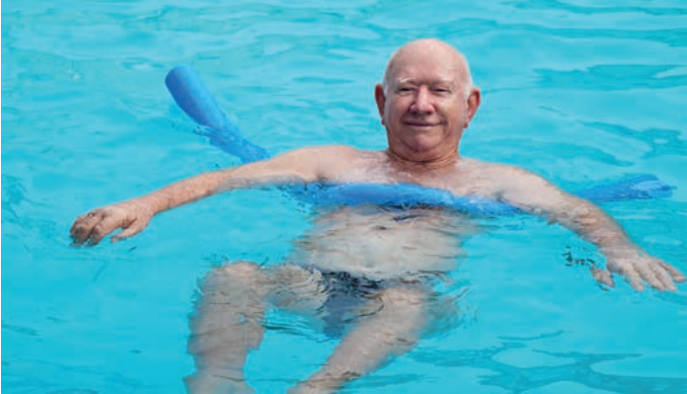

Transdisciplinary Case Study
SENIORS IN MOTION – Transdisciplinary
Approaches to Physical Activity Promotion
for Older People
Designing a transdisciplinary research project
SESSION 1

Slide 2
CONTENT
1. Learning objectives of the transdisciplinary case study
2. Physical activity for older people
3. Transdisciplinary research
4. Case Study structure and agenda
5. Task 0 - Group organization
5.1 Materials
6. Task 1 - Development of the TD Project
6.1 Materials
7. Task 2 - Preparation of presentations

Slide 3
learning objectives of the transdisciplinary case study
Learn some basics of transdisciplinary research and related methods by applying them to a real-world context
Gain insights in how to design transdisciplinary research projects
Work collaboratively in teams and find out about new tools and methods for effective team-work
Get to know your competencies as a transdisciplinary researcher
Adopt the role of a leading position in a transdisciplinary research project

Slide 4
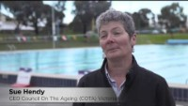
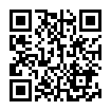
PHYSICAL ACTIVITY FOR OLDER PEOPLE
VIDEO from RACV (Royal Automobile Club of Victoria, Australia)

Slide 5
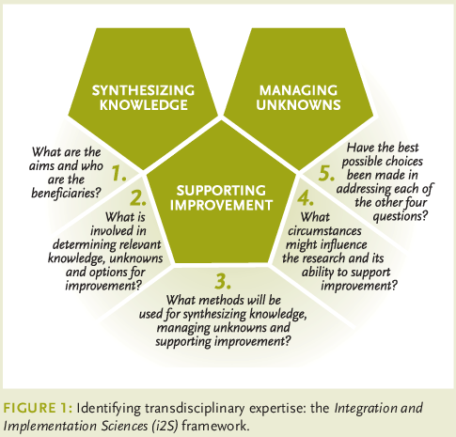
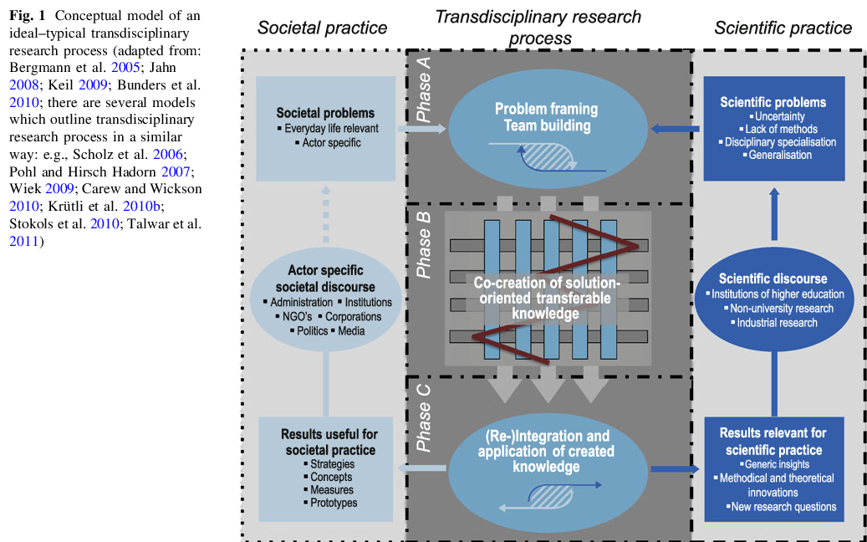
TRANSDISCIPLINARY RESEARCH
Lang, D. J., Wiek, A., Bergmann, M., Stauffacher, M., Martens, P., Moll, P., Swilling, M., & Thomas, C. J. (2012). Transdisciplinary research in sustainability science: practice, principles, and challenges. Sustainability Science, 7(S1), 25–43. https://doi.org/10.1007/s11625-011-0149-x
Bammer, G. (2019). What makes a researcher transdisciplinary? A framework to identify expertise: Frameworks for Transdisciplinary Research #8. GAIA - Ecological Perspectives for Science and Society, 28(3), 253. https://doi.org/10.14512/gaia.28.3.2

Slide 6
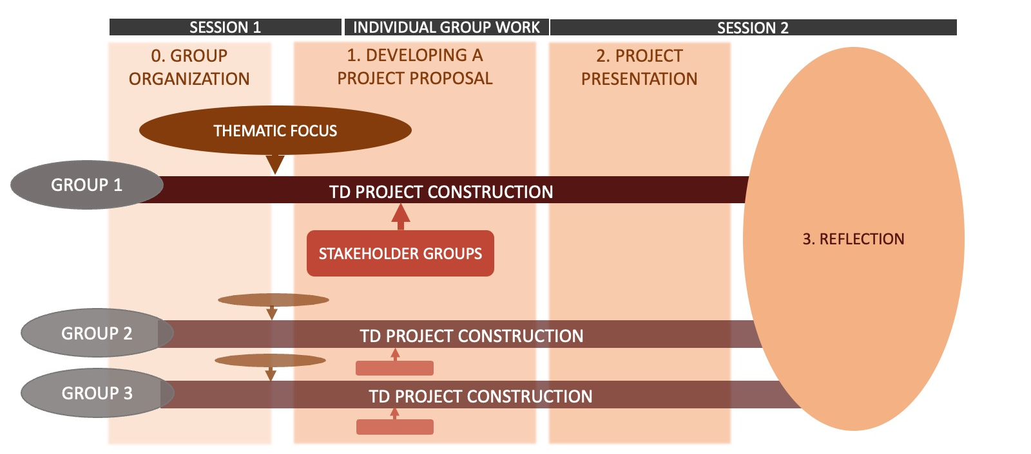
CASE STUDY STRUCTURE and agenda

Slide 7
CASE STUDY STRUCTURE - Main task
MAIN TASK
With your research team, develop a transdisciplinary research project spanning 3 years. Your goal is to research as well as promote physical activity of men and women 50+ in the city of Amberg, Bavaria.
Orientate your project setup on the three phases of the transdisciplinary research process outlined by Lang et al. (2012) and set out concrete steps and methods for each phase as well as a time schedule for the entire project duration.
Make sure to adapt your project design to the regional context of Amberg city.
You have unlimited personal and financial resources. If necessary, you can make assumptions on what is happening and how these developments are influencing your project process.

Slide 8

TASK 0 – GROUP ORGANIZATION

Slide 9
TASK 0: Group Organization
GROUP WORK
Get to know each other! If you would like, you can also share some information on the reflection task you prepared on your character, interests and competencies as a researcher prior to this session.
Organize and agree upon how you would like to work together as a group, e.g. a platform for group communication, data exchange and general operational principles.

Slide 10
TASK 0 – MATERIALS
GROUP ORGANIZATION

Slide 11
TASK 0: Materials
- Pointers for group organizatioN (1)
Group operation
  How do you make decisions?
  How do you ensure a positive mindset and fruitful collaboration?
Meeting routine
  e.g., implementing check-ins and check-outs
  (Changing) meeting roles: e.g., moderator, note taker, time-keeper, good-mood manager,...
Data management
  Where do you store your data?
  Where do you collect ideas?
Group communication
  On which platform do you communicate?
  Do you want to limit communication to a certain level?
  How quick should the individual reply time be?

Slide 12
TASK 0: Materials
- Pointers for group organizatioN (2)
For group communication
  Messengers such as Telegram or Signal.
  It can be beneficial to keep group communication off smartphones for a better work-life balance. In that case, there are other options such as:
  Rocketchat Leuphana
  Slack
For sharing and storing data
  Academic Cloud (find user information provided by Leuphana here)
  OneDrive
  Google Drive
  Dropbox
For creative purposes, e.g. brainstorming
  Padlet
  Miro
Notes:
Ideen gefragt/ gerne willkommen! Bitte hinzufügen :)

Slide 13
TASK 1A – THEMATIC FOCUS

Slide 14
TASK 1: DEVELOPING A FICTIONAL TD PROJECT
TASK A – THEMATIC FOCUS
A variety of context-related aspects are of relevance when setting up a transdisciplinary project in the field of physical activity promotion of older people in Amberg. Thus, each group will have a different thematic focus and related challenges, which they will address in particular throughout their project.
In your transdisciplinary project, the thematic focus will relate to and impact the content and methods you use and are thus important influences for your project construction.
In the material slides for Task 1A, you find exemplary thematic foci.

Slide 15
TASK 1: DEVELOPING A FICTIONAL TD PROJECT
TASK A – THEMATIC FOCUS
Briefly research your thematic focus (e.g., by reading 1-2 introduction papers).
Based on your thematic focus, identify aspects that could be relevant to your group's project planning (related to methods and/or content).

Slide 16
TASK 1A – MATERIALS
EXEMPLARY THEMATIC FOCI
The following exemplary thematic foci are also listed in the Case Description (page 10).

Slide 17
TASK 1A: Materials
- Exemplary thematic focus (1)
Focus 1: Reaching the target group of older people
Physical activity promotion for older people comes with its own set of challenges. In the past, some members of this age group could not be reached (Stadt Amberg, undated-d; Strobl, 2020; Strobl, Brew-Sam et al., 2020) e.g., because the offers were considered unappealing, the older people lacked contacts to other seniors and were not socially engaged, or because they suffered from old-age poverty and could not afford to participate in certain offers. In other cases, a limited mobility or movement difficulties of the seniors addressed prevented them from making their way to the venue. Moreover, the reasons for why different seniors suffer from poor health are manifold and need to be considered carefully (see composition of articles, pp. 3-4).
When designing and implementing your project, make sure to take into account these target group specific challenges and particularly reflect on how far the interests of the stakeholders you collaborate with align with the older people’s needs.

Slide 18
TASK 1A: Materials
- Exemplary thematic focus (2)
Focus 2: Physical activity promotion as a matter of gender
The way people deal with personal well-being and health issues is largely dependent on their gender. So is their perception of offers for physical activity promotion. In fact, many physical activity offers are unsuccessful in addressing men and hence are predominantly frequented by women. However, older women are anything but free from health impairment and further often hold a lower confidence in their health than men (see composition of articles, pp. 3-4).
During your project, put particular emphasis on gender (stereotypes) and gender-sensitive approaches – not only when devising solutions for physical activity promotion for older people, but also during the entire research process, including the collaboration with stakeholders and the implementation of transdisciplinary methods. How can your project appeal to citizens of all gender and contribute to breaking down gender stereotypes and making this a subject of discussion at the same time?

Slide 19
TASK 1A: Materials
- Exemplary thematic focus (3)
Focus 3: Physical activity promotion as an inter-generational endeavor
Which key experiences, influential factors, and turning points are there in life that affect how we value sports at a given point and to what extent we include physical exercise in our everyday life? One’s sports biography doesn’t start in old age. In fact, exercise habits in older age also depend on which role sports played during one’s childhood and youth (Hirvensalo & Lintunen, 2011). Young people hence represent an important target group when aiming to promote physical activity among older people in the long-term (Hirvensalo & Lintunen, 2011). At the same time, young people often find it difficult to relate to and empathize with older people’s needs and difficulties.
During your project, focus on actively addressing and involving younger people and making this a true inter-generational undertaking.

Slide 20
TASK 1A: Materials
- Exemplary thematic focus (4)
Focus 4: Tracking down the value of sports to Amberg citizens
People do not value sports and the different aspects there are to it in an equal manner (Jetzke & Mutz, 2020). To some, doing sports might imply being outdoors or spending time with friends, while others particularly appreciate the health benefits they derive from physical activity. To others, in turn, exercise is no more than free time and fun. Which value does the Amberg population see in physical activity?
Consider the differences in how people relate to sports in your project design to reach the members of the different target groups effectively and to come up with viable solutions.

Slide 21
TASK 1A: Materials
- Exemplary thematic focus (5)
Focus 5: Your Personal Topic of Interest
Which challenges do you see regarding the promotion of physical activity among older people in Amberg?
Feel free to focus your project on an even different topic (beyond Focus 1-4) and elaborate on your own ideas and interests.

Slide 22
TASK 1B – STAKEHOLDERS

Slide 23
TASK 1: DEVELOPING A FICTIONAL TD PROJECT
TASK B – STAKEHOLDERS
Each group chooses 3-5 stakeholders to collaborate with in their research project depending on the focus topic. Their choice of stakeholders will influence the project design.
For the selection, have a look at the selected list of stakeholders of the region (case description, appendix A, pp. 13-14) and do some additional research to consolidate your choice. You can also look up further relevant stakeholders on your own that you find necessary to include.
Then start working on the following questions (next pages), which will become important in your later project construction and in planning the stakeholder engagement.

Slide 24
TASK 1: DEVELOPING A FICTIONAL TD PROJECT
TASK B – STAKEHOLDERS
Questions for Reflection:
  Which goals and expectations do the stakeholders have?
  How will you integrate the stakeholders‘ goals and expectations into your research design (e.g., how do you combine these with your own goals and expectations)?
  How will you convince your stakeholders of your research design?
  Are there challenges you see in the collaboration with the stakeholders?

Slide 25
TASK 1: DEVELOPING A FICTIONAL TD PROJECT
TASK B – STAKEHOLDERS
Questions for Reflection (continued):
  How do you ensure to engage the targeted stakeholders from the start of the project and continuously over a longer period?
  How will you create a feeling of problem ownership among the stakeholders and prevent “just fulfilling a task”- or “not my problem”-attitudes?
  How are you planning to stimulate critical reflection among the stakeholders e.g., regarding the root causes of physical inactivity, the potential (lack of) impact of certain intervention ideas, and possible gains of cooperating with other institutions?
  How do you intent to manage potential power imbalances among the stakeholders involved in the project?

Slide 26
TASK 1B – MATERIALS
POTENTIAL STAKEHOLDERS
In Appendix A of the Case Description, you find an incomplete list of potential stakeholders in the region of Amberg.

Slide 27
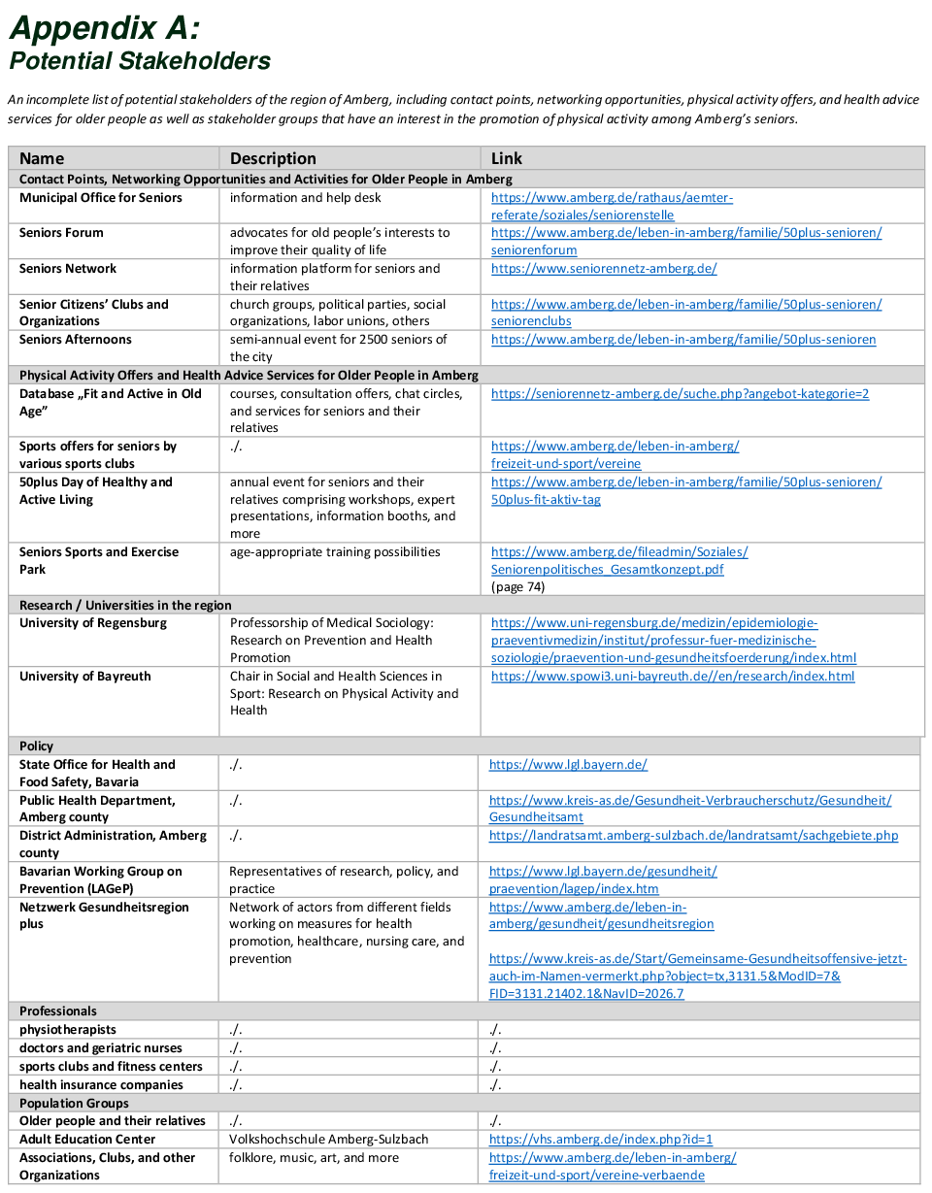
TASK 1B: Materials
- Potential stakeholders

Slide 28
TASK 1C – DEVELOP A PROJECT PROPOSAL

Slide 29
TASK 1: DEVELOPING A FICTIONAL TD PROJECT
TASK C - DEVELOP A PROJECT PROPOSAL
You are free to create a project proposal in any structure or form that you would like and to include any content in it, that you deem important. Please think about these questions:
  What is your schedule?
  Which methods will you use, when and why do you use them?
  How do you plan to integrate your thematic focus?
  How do you integrate your stakeholders?
  How did you take into account the regional context?
  How do you ensure that the project will result in societal and scientific impacts?

Slide 30

TASK 1: DEVELOPING A FICTIONAL TD PROJECT
NOTES FOR WORKING ON TASK 1
For your transdisciplinary approach…
… you can adopt the potential approaches and methods introduced in the case description (appendix C, pp. 15-16)
… or conduct your own search for appropriate research methods and elements for this transdisciplinary context.
The td-net toolbox offers a variety of tools and methods that you can apply in your TD project.

Slide 31

TASK 1: DEVELOPING A FICTIONAL TD PROJECT
NOTES FOR WORKING
ON TASK 1
An exemplary TD method:
What is design thinking? | Design thinking is a collaborative problem-solving strategy. Design thinking: a) connects the needs of people involved in the problem to researchers’/experts’ observations of the problem; b) focuses on creating innovative ways of looking at the problem; c) embraces visualization, storytelling, and experimentation through building and testing prototypes.
Why should it be applied? | In the context of research, design thinking is for: (1) co-designing research designs with stakeholders, and (2) co-designing implementation strategies of research outcomes. The approach is based on the assumption that framing problems in new ways can lead to more implementable and innovative solutions. In the context of education, design thinking can be used to build collaborative skills of students to tackle complex problems in interdisciplinary settings.
(Pearce 2020)
Notes:
If you are unsure how you can work on this task as a group, you might find it useful to have a look at the Design Thinking Approach. This approach could also be used as a method for co-designing with stakeholders in your TD-project.

Slide 32
TASK 1C – MATERIALS
TRANSDISCIPLINARY METHODOLOGIES

Slide 33
TASK 1C: Materials
- transdisciplinary research & methodologies
RECOMMENDED INFORMATION
td-net (2021): Tool-Box TD-net
Bammer, G. (2015): Eight Tool-Kits for transdisciplinarity
Bergmann, M. et al. (2012): Methods for Transdisciplinary Research
Pearce, B. (2020): Design Thinking
MORE IN DEPTH
Wiek & Lang (2016): Transformational Research
Bammer, G. (2019): Frameworks for transdiscplinary research

Slide 34
TASK 2 – PRESENTATION OF YOUR TD PROJECT

Slide 35
TASK 2: PRESENTATION OF YOUR TD PROJECT
Prepare a presentation of your project proposal for the second session of the course.
The presentation should be a maximum of 20 minutes long, followed by 10 minutes room for questions and discussion. The format of your presentation is free. Choose a format that is interesting for others and that expresses your project well.
Include the following information in your presentation:
  What is your schedule?
  How did you integrate your thematic focus?
  How did you integrate your stakeholders?
  How did you take into account the regional context?
  In which research phases did you use which methods and why?
  How can you ensure the success of your project?
  What are the scientific and societal impacts of your project?

Slide 36
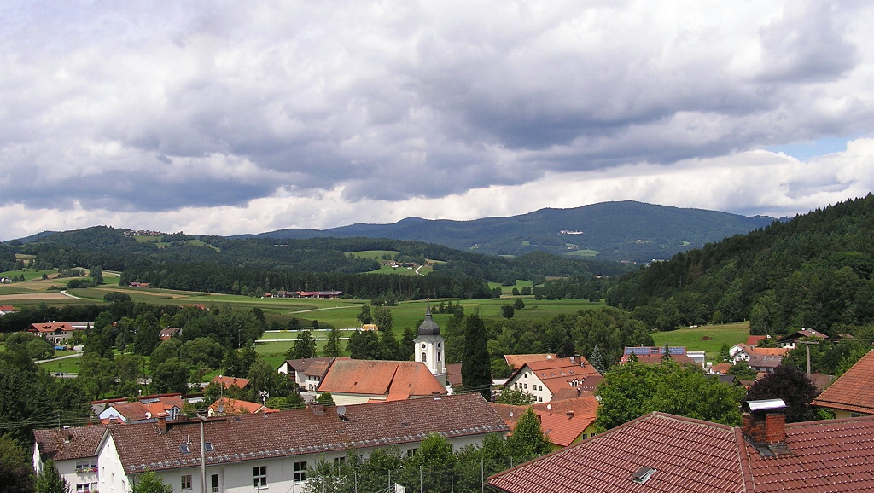
QUESTIONS?

