Slide 1
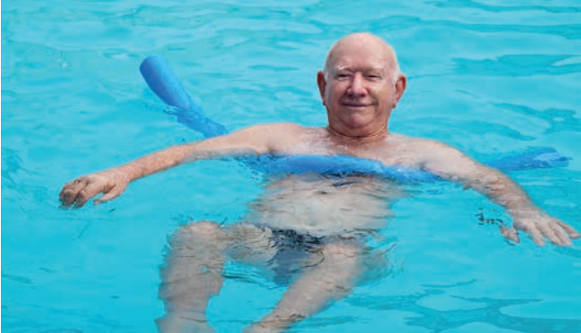

Transdisciplinary Case Study
SENIORS IN MOTION – Transdisciplinary
Approaches to Physical Activity Promotion
for Older People
Designing a transdisciplinary research project
SESSION 2

Slide 2
AGENDA
1. Group presentations
2. Case Study Reflection
2.1. Individually
2.2. Within the groups
2.3. On the fictious TD projects
3. What actually happened: ACTION for men – a subproject of Capital4Health
4. Feedback

Slide 3
Group Presentations
Please present your transdisciplinary project proposals in your chosen format.
20 mins presentation + 10 mins room for questions and discussion

Slide 4
Case study reflection
1. Individually
What was your role in the development of the TD project? How did you influence and fill it? What motivated you most during the work and what demotivated you?
2. Group
What are possible barriers, deficits or advantages of your research project? What went well in the group work? What could have been better?
3. In plenary discussion
How did the different thematic foci influence the projects?
How did the stakeholders influence the project?
Are there any ethical considerations that arise regarding research partnerships?
What other barriers could there be to implement the projects regarding limited resources and capacities?

Slide 5
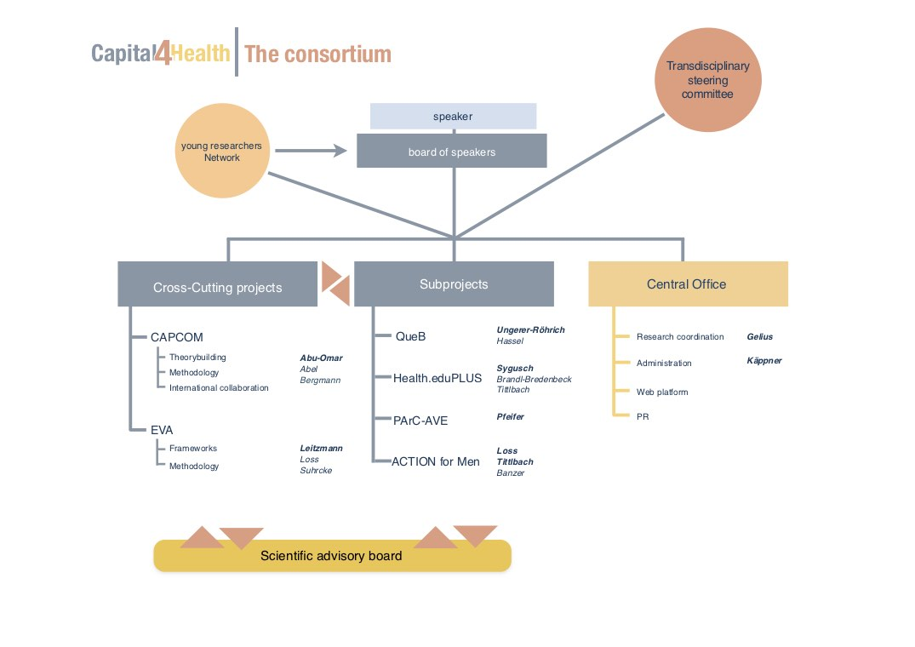
What really happened...
“Capabilites for active lifestyle: An interactive knowledge-to-action research network for health promotion”
A regionally based, transdisciplinary consortium from research institutions, policy and practice partners
Aims to develop and research:
  capabilities for active lifestyles among different population target groups and among professional target groups
  the structural capacities located at the organizational and system level
Project duration: 2015-2021
Website: https://capital4health.de/

Slide 6
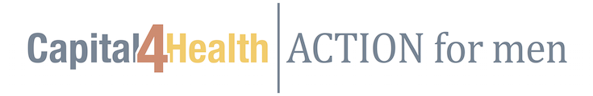
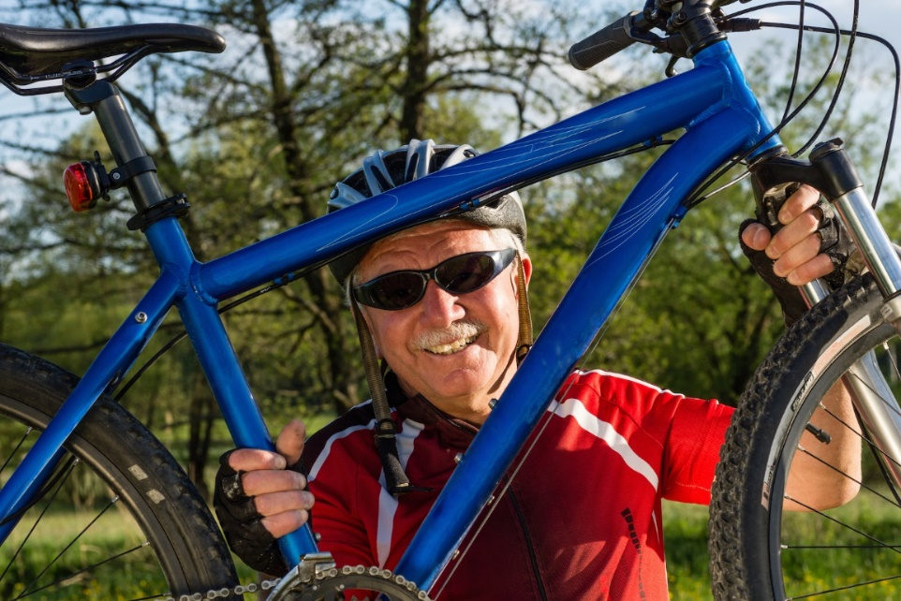
What really happened...
Study Aims:
  To establish stakeholder groups in two communities that are willing to meet regularly to plan exercise interventions for older men.
  To monitor and examine the capacity building processes that take place in these stakeholder groups, in order to understand whether participatory approaches on the community level are effective in developing and implementing local physical activity interventions.
Methods:
  Questionnaire survey and qualitative intervies on demands, needs, and barriers of the target group
  Establishment and moderation of community working groups to develop and implement physical activity offers for the target group
Interventions: website, leaflets, SportCard, outdoor activity meetings, German Sports Insignia
Target group: physically inactive men 50+ in two communities (10.000 - 20.000 inhabitants each) in the region of Amberg-Sulzbach, Bavaria
Capacity Building was successful to a certain degree, but subsided with time
(Loss et al. 2020)

Slide 7
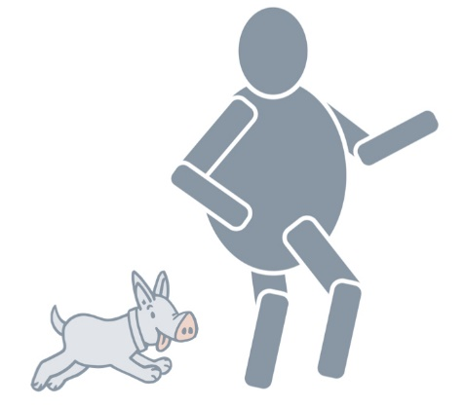
What really happened...
Challenges experienced in the stakeholder groups:
Passivity and power imbalances
  Participation was appreciated by group members, but also criticized for delaying the process
  Community B: Leadership of one person and power relations at the expense of stronger participation of other group members
  Community A: passive group, relied on researchers for task delegation and management
Dominated by sports clubs and their topics
  Interventions focused on organized sports courses
  Other participants left the group due to feeling excluded
Lack of reflexivity
  Group members did not feel the need to develop their capacities further due to a relatively high initial capacity level
  Group members did not question the usefulness or effectiveness of their interventions
  Scientists had difficulties stimulating critical reflections without being mistaken for discrediting participants’ efforts
  Group members had no discernible interest to understand underlying problem causes and discuss barriers
Low sense of responsibility
  Responsibility was seen with researchers due to initial top-down approach (groups and agenda determined by researchers)
  Community A discontinued meetings after 11 months (had “fulfilled their task”)
(Loss et al. 2020)

Slide 8
What really happened...
Publications:
Loss, J., Brew-Sam, N., Metz, B., Strobl, H., Sauter, A., & Tittlbach, S. (2020). Capacity Building in Community Stakeholder Groups for Increasing Physical Activity: Results of a Qualitative Study in Two German Communities. International Journal of Environmental Research and Public Health, 17(7). https://doi.org/10.3390/ijerph17072306
Strobl, H., Brew-Sam, N., Curbach, J., Metz, B., Tittlbach, S., & Loss, J. (2020). Action for Men: Study Protocol of a Community Capacity Building Intervention to Develop and Implement Gender-Sensitive Physical Activity Programs for Men 50 Plus. Frontiers in Public Health, 8, 1–9. https://doi.org/10.3389/fpubh.2020.00004
Strobl, H. (2020). Theoretical underpinnings of interventions that effectively promote physical activity in adult men. German Journal of Exercise and Sport Research, 50(1), 162–178. https://doi.org/10.1007/s12662-019-00631-z

Slide 9

FEEDBACK
Please fill in the Feedback Form:
https://campus.lamapoll.de/Feedback-TD-Case-Study

Slide 10
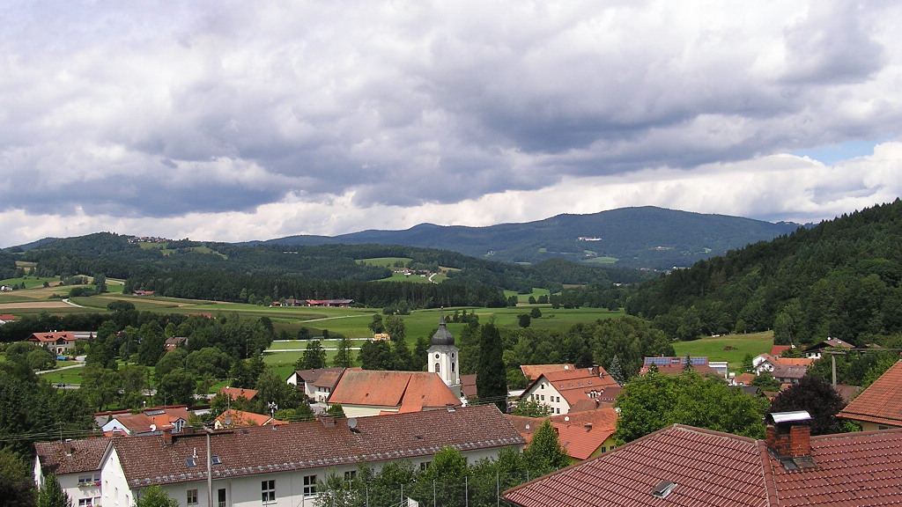
thank you!
For your participation

