Slide 1
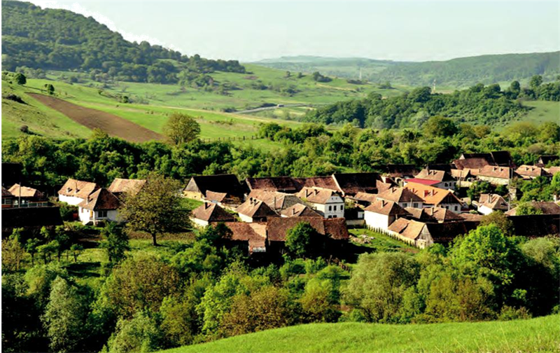




Transdisciplinary Case Study of Southern Transylvania
FROM VISIONS TO REALIZATIONS –
Keeping the past alive while enabling the future
Designing a transdisciplinary research project
SESSION 1

Slide 2
CONTENT
1. Learning objectives of the transdisciplinary case study
2. The region of Southern Transylvania
3. Case Study structure and agenda
4. Task 0 - Group organization
4.1 Materials
5. Task 1 - Development of the TD Project
5.1 Materials
6. Task 2 - Preparation of presentations

Slide 3
learning objectives of the transdisciplinary case study
Learn some basics of transdisciplinary research and related methods by applying it to a real-world context
Gain insights in how to design transdisciplinary research projects
Work collaboratively in teams and find out about new tools and methods for effective team-work
Get to know your competencies as a transdisciplinary researcher
Adopt a role as a leading position in a transdisciplinary research project

Slide 4
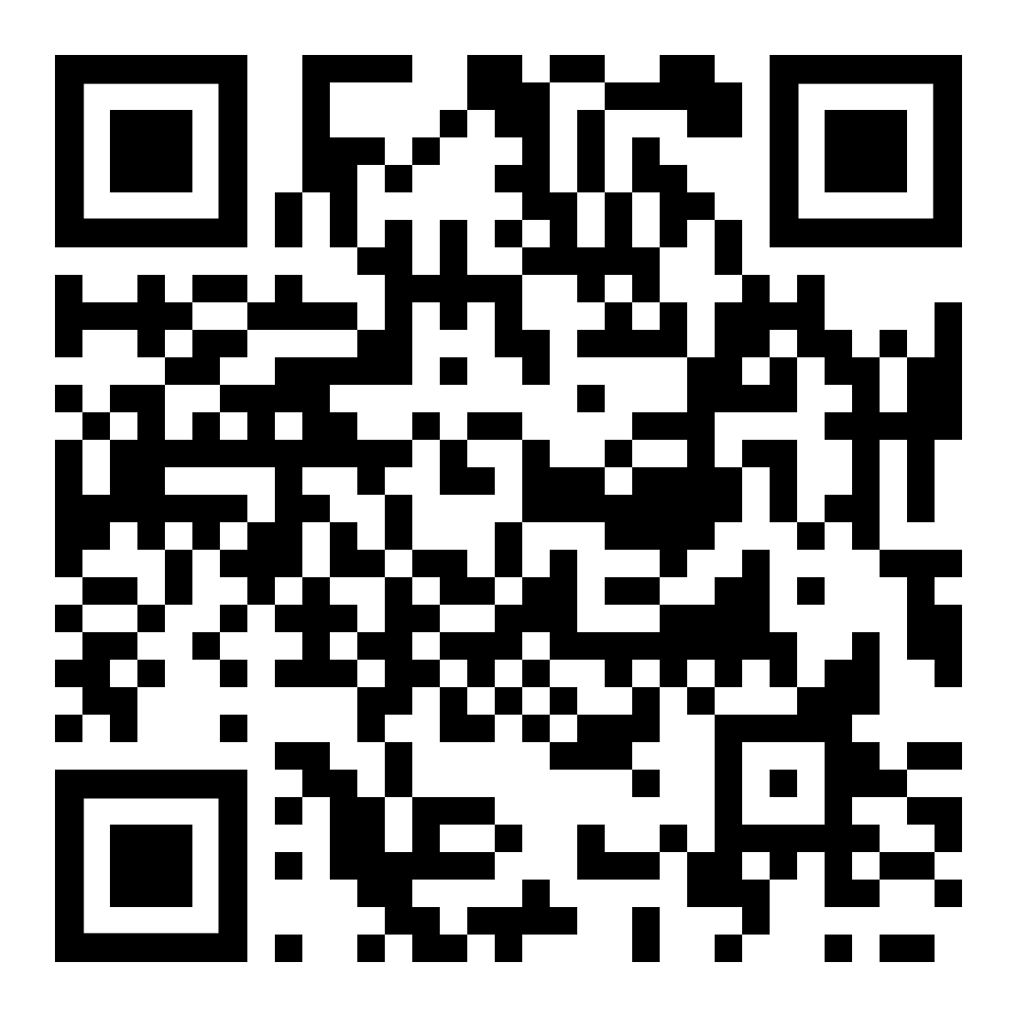
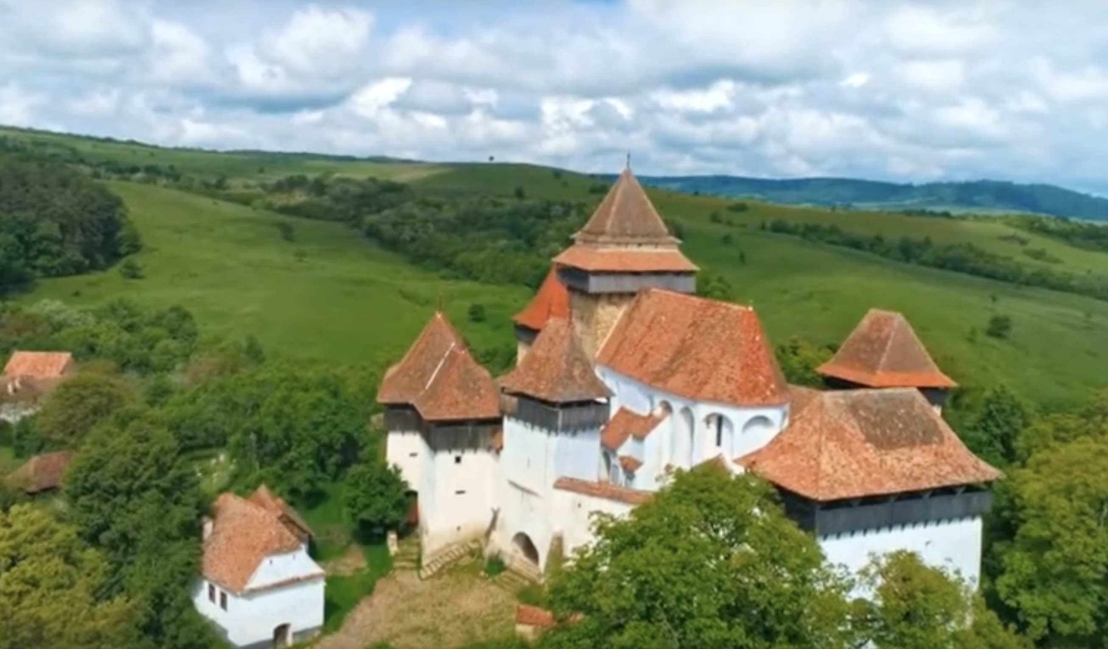
THE REGION OF SOUTHERN TRANSYLVANIA
VIDEO from WWF Romania & Transylvanian Highlands (Eco-tourism Board)

Slide 5
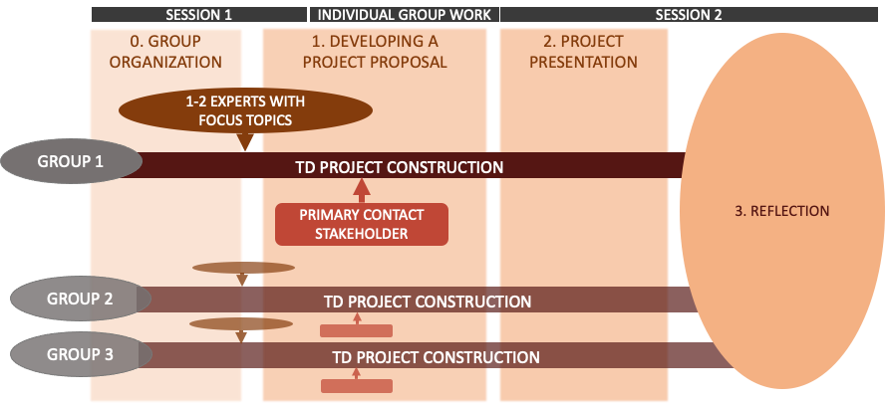
CASE STUDY STRUCTURE and agenda

Slide 6
CASE STUDY STRUCTURE - Main task
MAIN TASK
With your research team, develop a transdisciplinary project spanning 3 years. Its goal is to set in motion critical development for making the scenario Balance brings Beauty reality. You have unlimited personal and financial resources.
If necessary, you can make assumptions on what is happening and how these developments are influencing your project process.

Slide 7
TASK 0: Group Organization
GROUP WORK
Get to know each other! Share your thoughts on the reflection task you prepared on your character, interests and competencies as a researcher prior to this session.
Which of your competencies (i.e., knowledge, skills, attitudes) can help you and your group in designing a transdisciplinary project?
Organize and agree upon how you would like to work together as a group, e.g. a platform for group communication, data exchange and general operational principles.

Slide 8

MATERIALS TASK 0

Slide 9
TASK 0: Materials
- Pointers for group organizatioN (1)
Group operation
  How do you make decisions?
  How do you ensure a positive mindset and fruitful collaboration?
Meeting routine
  E.g. implementing Check ins and Check outs
  (Changing) meeting roles: e.g. moderator, note taker, time keeper, good-mood manager,...
Data management
  Where do you store your data?
  Where do you collect ideas?
Group communication
  On which platform do you communicate?
  Do you want to limit communication to a certain level?
  How quick should the individual reply time be?

Slide 10
TASK 0: Materials
- Pointers for group organizatioN (2)
For group communication
  Messengers such as Telegram or Signal.
  It can be beneficial to keep group communication off smartphones for a better work-life balance. In that case, there are other options such as:
  Rocketchat Leuphana
  Slack
For creative purposes, e.g. brainstorming
  Padlet
  Miro
For sharing and storing data
  Academic Cloud (find user information provided by Leuphana here)
  OneDrive
  Google Drive
  Dropbox
Notes:
Ideen gefragt/ gerne willkommen! Bitte hinzufügen :)

Slide 11
TASK 1

Slide 12
TASK 1: DEVELOPING A FICTIONAL TD PROJECT
TASK 1A - EXPERTS
You will select two members in your research team, which will take the roles of scientific experts of a certain field.
In your transdisciplinary project, the focus of your experts will relate to and impact the content and methods you use and are thus important influences for your project construction.
The individual focus can be chosen by the experts' or your group's interest. For this, you are encouraged to draw upon the reflection task you received before this session.
In the material slides for Task 1, you find inspiration for possible focus topics.

Slide 13
TASK 1: DEVELOPING A FICTIONAL TD PROJECT
INDIVIDUAL WORK
TASK 1A - EXPERTS
Briefly research your focus topic and read 1-2 introduction papers.
Take on the perspective of your focus topic and identify aspects that could be relevant to your group's project planning (related to methods and/or content).

Slide 14
TASK 1A: MATERIALS
- EXEMPLARY FOCUS TOPICS FOR EXPERTS

Slide 15
TASK 1A: MATERIALS –
EXEMPLARY FOCUS TOPICS FOR EXPERTS
Leverage Points & Sustainability Transformations
Abson, D.J., Fischer, J., Leventon, J. et al. (2017): Leverage points for sustainability transformation.
Manlosa, A.O., Schultner, J., Dorresteijn, I. et al. (2018): Leverage points for improving gender equality and human well-being in a smallholder farming context.
Systems Thinking
Meadows, D. H. (2008): Thinking in Systems.
Arnold, R. D., Wade, J. P. (2015): A Definition of Systems Thinking: A Systems Approach
Resilience Thinking
Stockholm Resilience Centre (n.D.): Applying resilience Thinking. Seven principles for building resilience in social-ecological systems.
Feminist Research Approaches
Gottschlich, D., & Katz, C. (2016). Sozial-ökologische Transformation braucht Kritik an den gesellschaftlichen Naturverhältnissen. Soziologie Und Nachhaltigkeit, 2(1).
Jerneck, A. (2018). What about gender in climate change? Twelve feminist lessons from development. Sustainability, 10(3), 627.
Notes:
English source for Feminist research approaches still required

Slide 16
TASK 1: DEVELOPING A FICTIONAL TD PROJECT
TASK 1B - PRIMARY CONTACT STAKEHOLDERS
Each group receives one stakeholder that they will primarily involve in their research project.
Have a look at the information you are provided with in the material slides and do some additional research. Then start working on the following questions, which will become important in your later project construction:
  Which goals and expectations does the stakeholder have?
  How will you integrate the stakeholder's goals and expectations into your research design (e.g. how do you combine these with your own goals and expectations)?
  Are there challenges you see in the collaboration with the stakeholder?
  How will you convince your stakeholder of your research design?

Slide 17
TASK 1B: MATERIALS
- PRIMARY CONTACT STAKEHOLDERS
One of the following three local sustainability intitatives/ NGOs in Southern Transylvania will serve as a primary contact stakeholder for your working group. More information about your contact stakeholder and their work can be found on the ascribed website(s).

Slide 18
TASK 1B: MATERIALS - Mihai Eminescu Trust
Since 1998, the Mihai Eminescu Trust (MET) foundation has been involved in preserving the local heritage and has been actively contributing to the resettlement of the villages and communes of Transylvania and Maramureș, two of the most authentic areas in Europe. MET believes that all projects built through the use of heritage must have people living in their immediate vicinity, who benefit from and care for them in the center. To date, MET has succeeded in moving people from local Transylvanian communities through more than 1,500 projects developed in 26 villages and 5 cities. Specifically, MET trains the locals in traditional construction techniques and practices for agrotourism. Organizes English courses, promotes entrepreneurship and involvement locally. It offers support for the development of small tourism-related businesses, revitalizing village orchards and planting local varieties in areas where the forest is in full swing.
(Text from https://en.colinele-transilvaniei.ro/our-partners)
Link to old foundation website: http://www.mihaieminescutrust.org/about-us
Link to new foundation website: https://www.mihaieminescutrust.ro/en/

Slide 19
TASK 1B: MATERIALS - Fundatia ADEPT
The ADEPT Transilvania Foundation is dedicated to the conservation of biodiversity and rural development, since 2004 giving priority to the protection of High Natural Value agricultural landscapes in Transylvania. It supports communities of small farmers, who have modeled over the centuries and preserve these landscapes. It works with farmers, local communities, universities, NGOs and with the Ministries of the Government of Romania to find solutions to the problems that threaten the survival of remarkable landscapes and local communities of farmers. ADEPT carries out programs that combine economic and social benefits with biodiversity conservation and increasing local capacity for good management in the future.
(Text adapted from https://en.colinele-transilvaniei.ro/our-partners)
Link to Foundation Website: https://fundatia-adept.org/

Slide 20
TASK 1B: MATERIALS - SCHUBZ România
SCHUBZ is a center of education for sustainable development in Râşnov, Romania. It works in a multinational network of experts and partners - SCHUBZ brings to Romania interactive, experiential training and methods in the field of Education for Sustainable Development. SCHUBZ aims to lead children and teenagers in developing a new attitude and way of living, bringing sustainability to their life by creating experiences, which connect children to nature and its importance for their life. At the same time, the center values local heritage and traditions, connecting local communities to nature and its resources.
The center works with schools, families, universities and non-governmental organizations to share knowledge and experience about education for sustainable development in Romania and abroad.
(Text adapted from center’s website).
Link to website: https://schubz.ro/en/

Slide 21
TASK 1: DEVELOPING A FICTIONAL TD PROJECT
TASK 1C - DEVELOP A PROJECT PROPOSAL
You are free to create a project proposal in any structure or form that you would like and to include any content in it, that you deem important. Please think about these questions:
  What is your schedule?
  Which methods will you use, when and why do you use them?
  How do you plan to integrate your focus topics?
  How do you integrate your primary contact stakeholder?
  How do you ensure that the project will result in societal and scientific impacts?

Slide 22
TASK 1C: MATERIALS
- DEVELOPING A PROJECT PROPOSAL

Slide 23
TASK 1C: MATERIALS
- TRANSDISCIPLINARY RESEARCH AND METHODOLOGIES
RECOMMENDED INFORMATION
td-net (2021): Tool-Box TD-net
Bammer, G. (2015): Eight Tool-Kits for transdisciplinarity
Bergmann, M. et al. (2012): Methods for Transdisciplinary Research
MORE IN DEPTH
Wiek & Lang (2016): Transformational Research
Bammer, G. (2019): Frameworks for transdiscplinary research
Pearce, B. (2020): Design Thinking

Slide 24
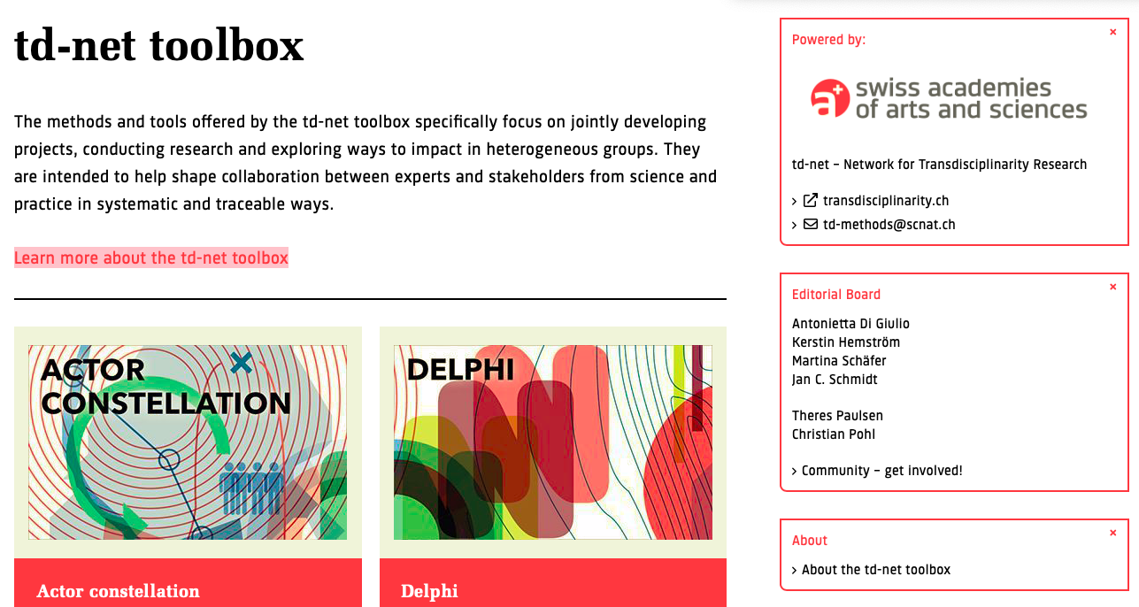
TASK 1C: MATERIALS - USEFUL TOOLS
The td-net toolbox offers a variety of tools and methods that you can apply in your TD project

Slide 25

TASK 1C: MATERIALS – AN EXAMPLARY TD METHOD
What is design thinking? | Design thinking is a collaborative problem-solving strategy. Design thinking: a) connects the needs of people involved in the problem to researchers’/experts’ observations of the problem; b) focuses on creating innovative ways of looking at the problem; c) embraces visualization, storytelling, and experimentation through building and testing prototypes.
Why should it be applied? | In the context of research, design thinking is for: (1) co-designing research designs with stakeholders, and (2) co-designing implementation strategies of research outcomes. The approach is based on the assumption that framing problems in new ways can lead to more implementable and innovative solutions. In the context of education, design thinking can be used to build collaborative skills of students to tackle complex problems in interdisciplinary settings.
(Pearce 2020)
Notes:
If you are unsure how you can work on this task as a group, you might find it useful to have a look at the Design Thinking Approach. This approach could also be used as a method for co-designing with stakeholders in your TD-project.

Slide 26
TASK 2

Slide 27
TASK 2: PRESENTATION OF YOUR TD PROJECT
Prepare a presentation of your project proposal for the second session of the course.
The presentation should be 10-15 minutes long, followed by 5 minutes room for questions and discussion. The format of your presentation is free. Choose a format that is interesting for others and that expresses your project well.
Include the following information in your presentation:
  What is your schedule?
  How did you integrate your focus topics?
  How did you integrate your primary contact stakeholder?
  In which research phases did you use which methods and why?
  How can you ensure the success of your project?
  What are the scientific and societal impacts of your project?

Slide 28
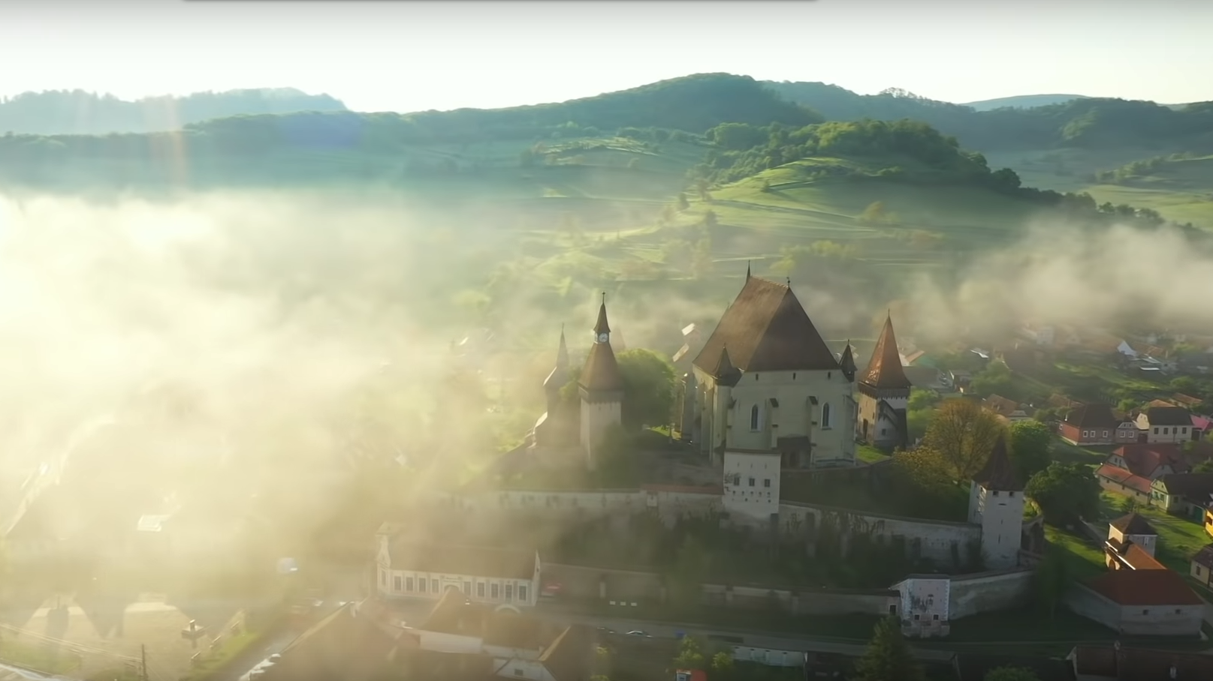
QUESTIONS?

