Slide 1
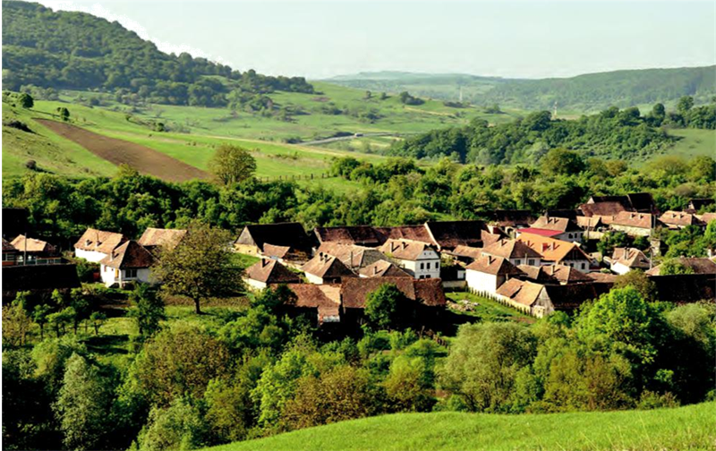




Transdisciplinary Case Study of Southern Transylvania
FROM VISIONS TO REALIZATIONS –
Keeping the past alive while enabling the future
Designing a transdisciplinary research project
SESSION 2

Slide 2
AGENDA
1. Group presentations
2. Case Study Reflection
2.1. Individually
2.2. Within the groups
2.3. On the fictious TD projects
3. What actually happened: Leverage points project in Southern Transylvania
4. Feedback

Slide 3
Group Presentations
Please present your transdisciplinary project proposals in your chosen format.
10-15 mins presentation + 5 mins room for questions and discussion

Slide 4
Case study reflection
A. Individually
What was your role as a researcher in the development of the TD project? How did you influence and fill it? What motivated you most during the work and what demotivated you?
B. Within the groups
What are possible barriers, deficits or advantages of your research project? What went well in the group work? What could have been better?
C. On the fictitious TD projects in plenary discussion
How did the different experts and focus topics influence the projects?
How did the stakeholders influence the project?
Are there any ethical considerations that arise regarding research partnerships?
What other barriers could there be to implement the projects regarding limited resources and capacities?

Slide 5
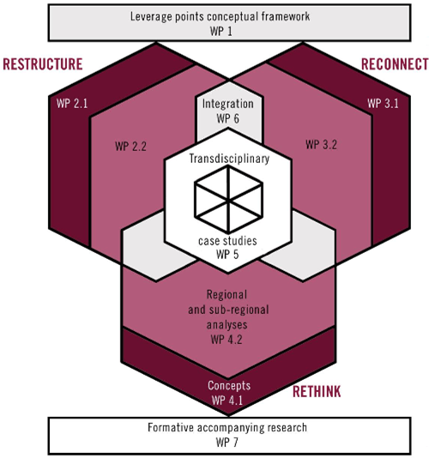
What really happened...
Leverage Points for Sustainability Transformation
- Case Study Transylvania
(Jan 2016 - March 2019)

Slide 6
What really happened...
Leverage Points for Sustainability Transformation
Video presentation of project by Daniel J. Lang (37 min.)

Slide 7
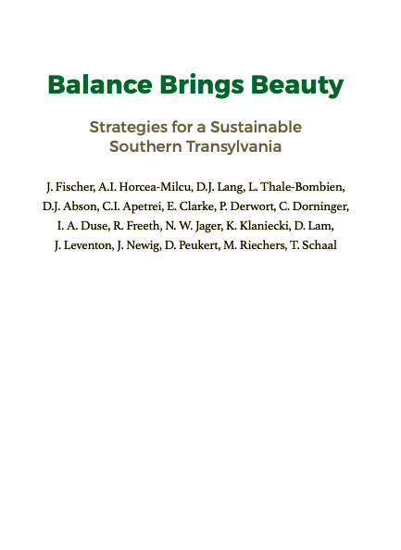
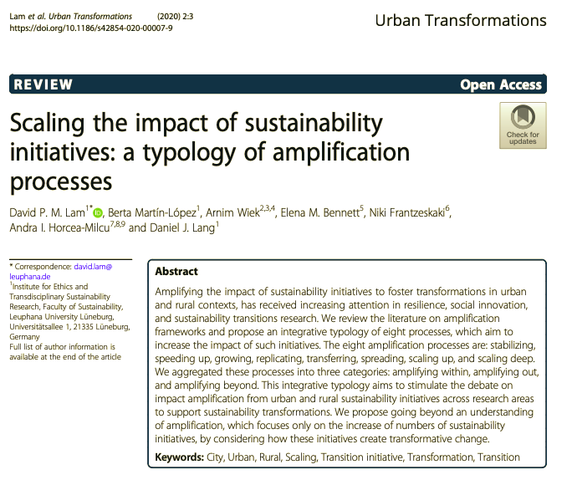
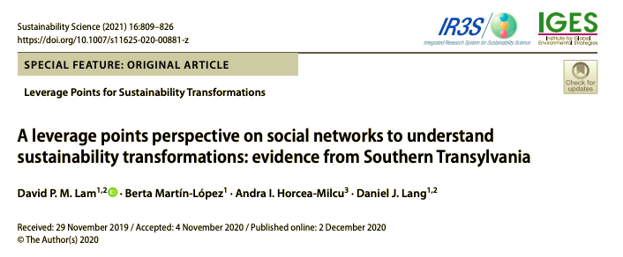
What really happened...
J. Fischer, A.I. Horcea-Milcu, D.J. Lang, L. Thale-Bombien, D.J. Abson, C.I. Apetrei, E. Clarke, P. Derwort, C. Dorninger, I. A. Duse, R. Freeth, N. W. Jager, K. Klaniecki, D. Lam, J. Leventon, J. Newig, D. Peukert, M. Riechers, T. Schaal. (2019). Balance Brings Beauty: Strategies for a Sustainable Southern Transylvania. Pensoft. https://leveragepointsdotorg.files.wordpress.com/2019/03/balance-brings-beauty_en.pdf
Lam, D. P. M., Martín-López, B., Wiek, A., Bennett, E. M., Frantzeskaki, N., Horcea-Milcu, A. I., & Lang, D. J. (2020). Scaling the impact of sustainability initiatives: a typology of amplification processes. Urban Transformations, 2(1). https://doi.org/10.1186/s42854-020-00007-9. https://urbantransformations.biomedcentral.com/track/pdf/10.1186/s42854-020-00007-9.pdf
Lam, D. P. M., Martín-López, B., Horcea-Milcu, A. I., & Lang, D. J. (2020). A leverage points perspective on social networks to understand sustainability transformations: evidence from Southern Transylvania. Sustainability Science. Advance online publication. https://doi.org/10.1007/s11625-020-00881-z

Slide 8

FEEDBACK
To improve this Case Study and to create better capacity buidling offers in the future, please fill in this feedback form for tdAcademy (permanent link):
https://survey.lamapoll.de/Feedback-TD-Case-Study

Slide 9
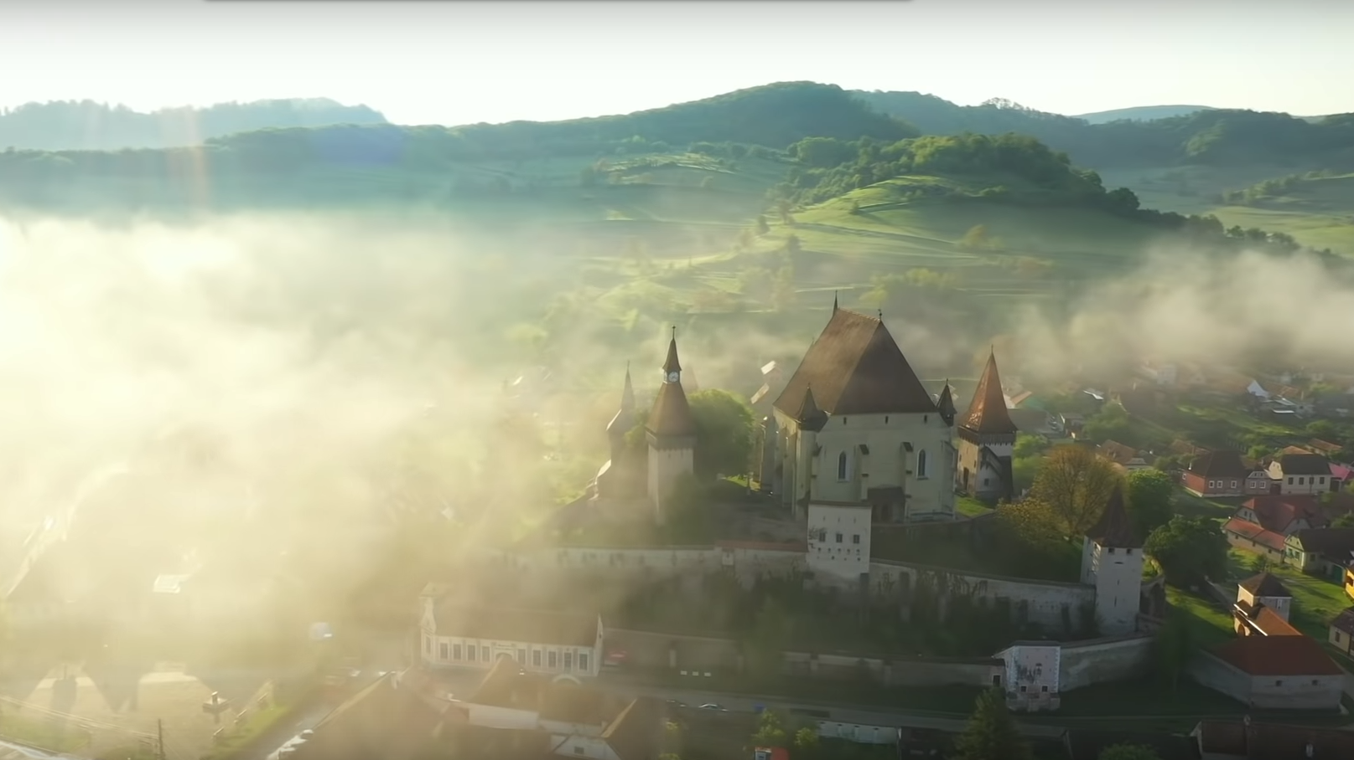
thank you
for your participation!

